Slide 1
Climathon
Sprint 3 & Introduction
Team Climathon

Slide 2
THIS IS
OUR
TEAM
JOHNATHAN MOORE
Mădălina IfriM
NINA POPVICI
GARY HERELLE
DANNY Buckley
Project Manager
Marketing
UX Designer
UX Designer
Developer

Slide 3
AGENDA
OUR CONCEPT
MARKETING
TIMELINE
TECHNOLOGY
DESIGN
Mercury is the closest planet to the Sun. It’s a bit larger than our Moon
Despite being red, Mars is actually a cold place. It’s full of iron oxide dust
Neptune is the fourth-largest planet by diameter in our Solar System
Saturn is the ringed one. It’s composed mostly of hydrogen and helium
Venus has a beautiful name and is the second planet from the Sun

Slide 4

"Divided, we think. Together, we share. United, we Innovate."

Slide 5
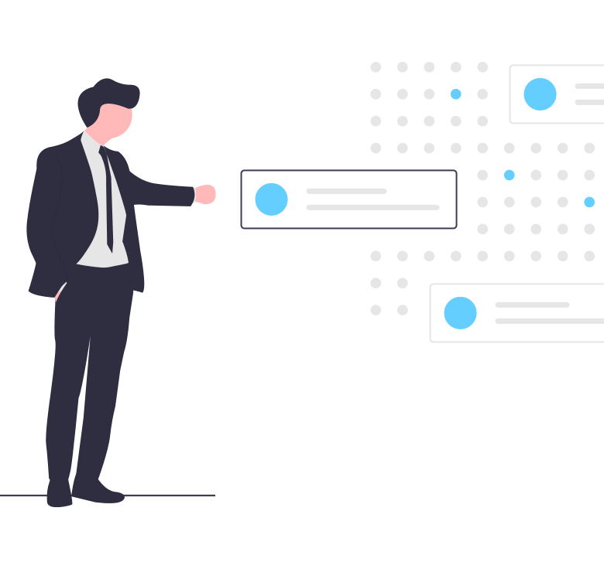


Our Concept
The Challenge Themes
October
24th-25th
Diversified
themes
Virtual event

Slide 6
Our Concept
The Challenge Themes
England
Ireland
Air Pollution
Traffic Congestion
Renewable Energy
Water quality
Scotland
Wales
Flooding Reducing GHG emissions
Flooding
Species Extinction

Slide 7
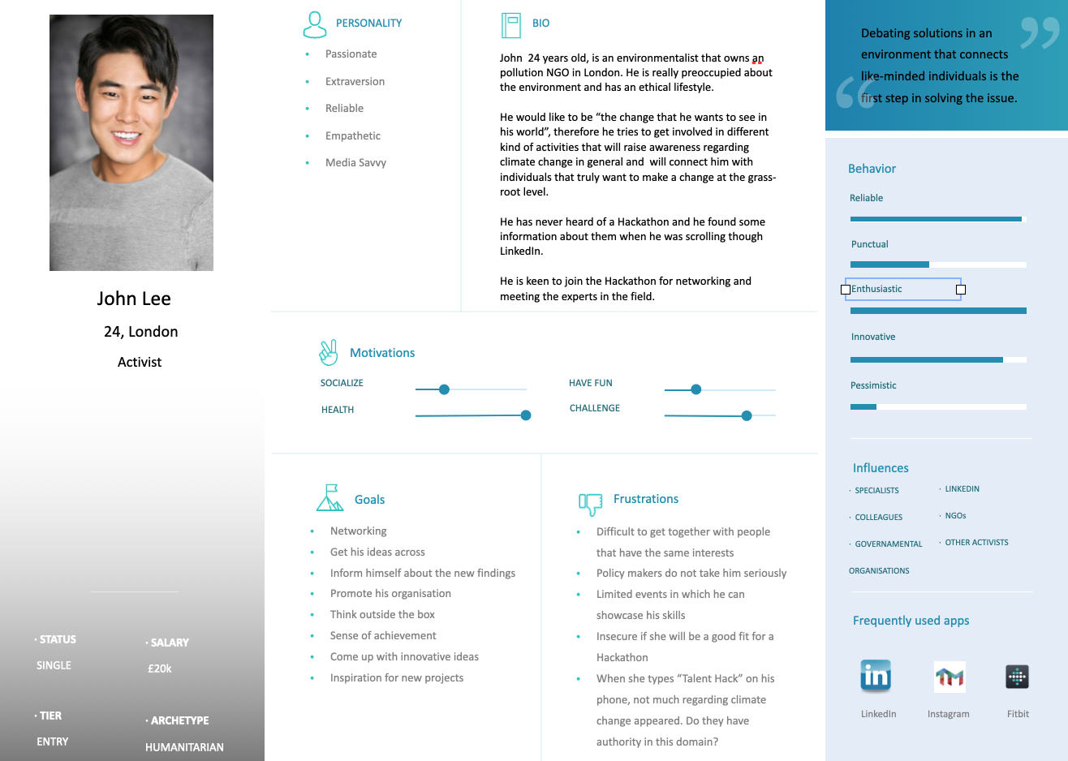
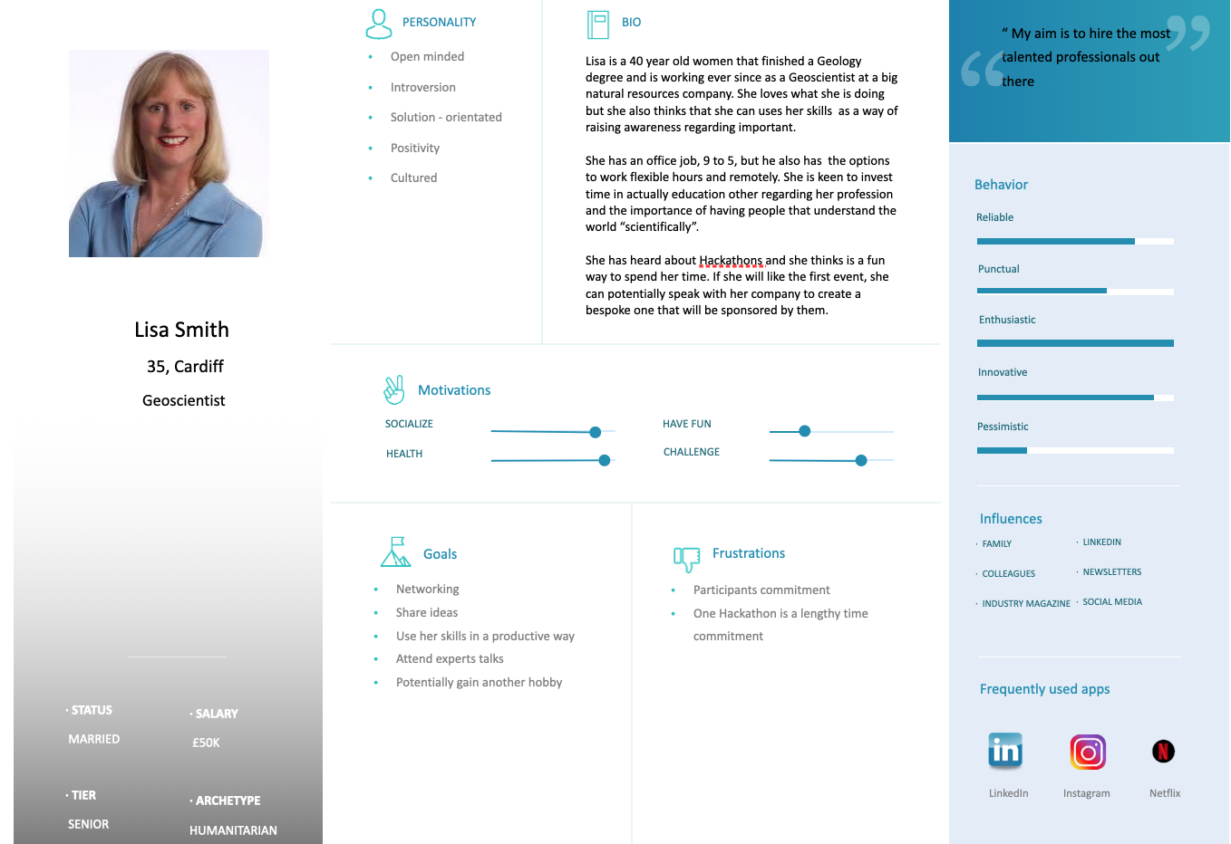
Who we are targeting
Participants
Type
Creative individuals who have a passion for progressive climate change action, looking for a platform to transform their ideas.
The key is to be intrinsically motivated by the subject, but specific beackground in environmental science, programming, web developing or designing would be a bonus.
A blend of skill-sets is what makes a good team!
Sources
Universities

Slide 8


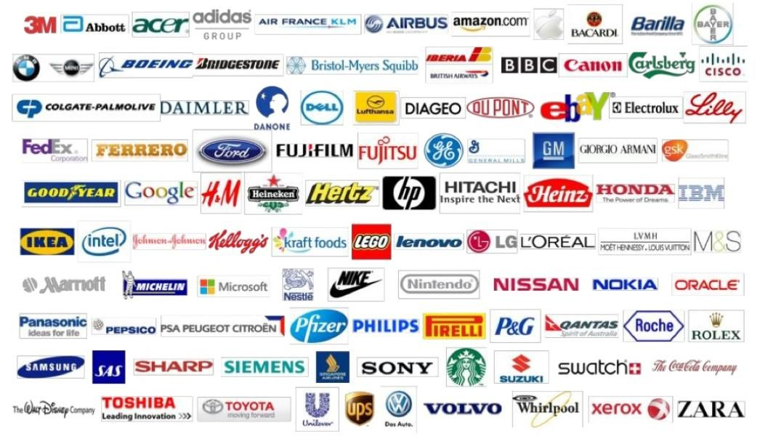
Who we are targeting
Sponsors/Partners
Partner organisations
InnovateUK
London Climate Change Partnership
Governing bodiesCentre for Climate Change and Social Transformations
“Giants” willing to invest in CSR
Start-ups that are interested in climate change

Slide 9
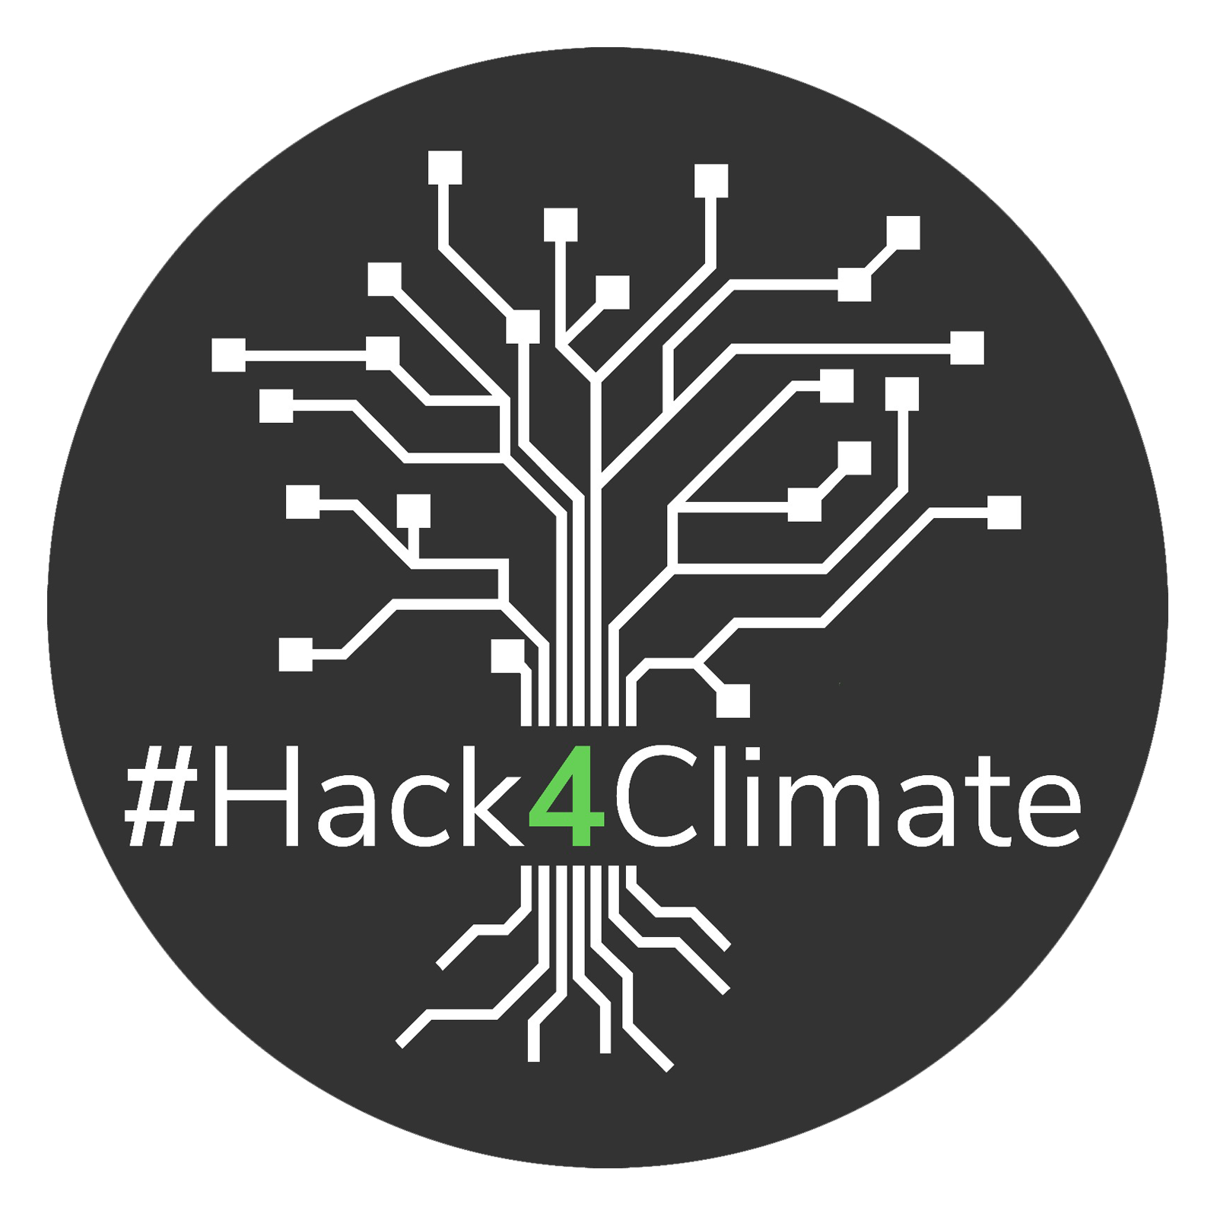


Competitor Analysis
Hack4Climate
Copernicus
Clyde & Co
+ Open to variety of disciplines
+ Established partner groups
- Challenges appear heavily technology based
+Established reputation
+Funded by European Comission
- No upcoming events
- Appears UK will be affected by participation post-Brexit
+Virtual climate change hackathon
- Narrow scope - only legal professionals can participate

Slide 10
Our Concept – Added Value
Adding value through a virutal event, captialising on the
potential reach for a greater target audience than
tradidtional city-focused Climathon's.
Utlising theme of compeititon to play nations off against each other, creating an evironment that will aim to achieve the most innovative results through home-nation rivalry.
Engaging people to think creatively about solutions to the most prominent climate change affects which are impacting
where they live.

Slide 11
Marketing Strategy
Social media platforms | Week 1 | Week 2 | Week 3 | Week 4 | Week 5 | Week 6
Facebook Instagram | Why a Hackathon? Why TH? | England |  | Scotland | Wales | Final countdown until the end of the application window
Twitter | Why a Hackathon? Why TH? | Wales | England | Ireland | Scotland | Final countdown until the end of the application window
Ireland

Slide 12
Marketing Strategy
TikTock | Why a Hackathon? Why TH? | #Globalwarning challenges | Create a specific challenge for every participant from every region and try to make it popular
Facebook Instagram | Why a Hackathon? Why TH? | Importance of CRS for a business | Legal initiatives from every region | Start-ups and innovation hubs that are connected with that topics/ sponsors blog posts
Recruitment events | Considering strategic partnerships with universities and student unions

Slide 13
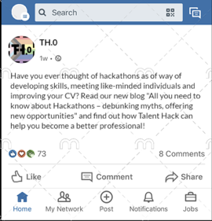
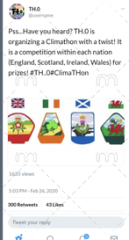
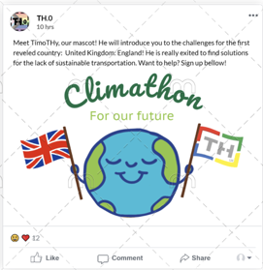
Mockups
Social Media
You can replace the image on the screen with your own work. Just delete this one, add yours and send it to the back

Slide 14
Marketing Strategy - KPIs
1
Lead to Customer ratio- How many leads we get through our campaign ​
Registrations for the event
Landing Page conversion rates​
2
Inbound Marketing​
Organic Traffic- Reach through SEO/Blogs ​
Sales team success rate- Number of sponsors/interested companies​
3
Social media metrics- Follows/views/likes/ shares
Returning participants
Performance of payed media

Slide 15
BLOG
All you need to know about Hackathons – debunking myths, offering new opportunities
Honestly. Passion. Friendly. Interactive. Innovative. Trust.

Slide 16
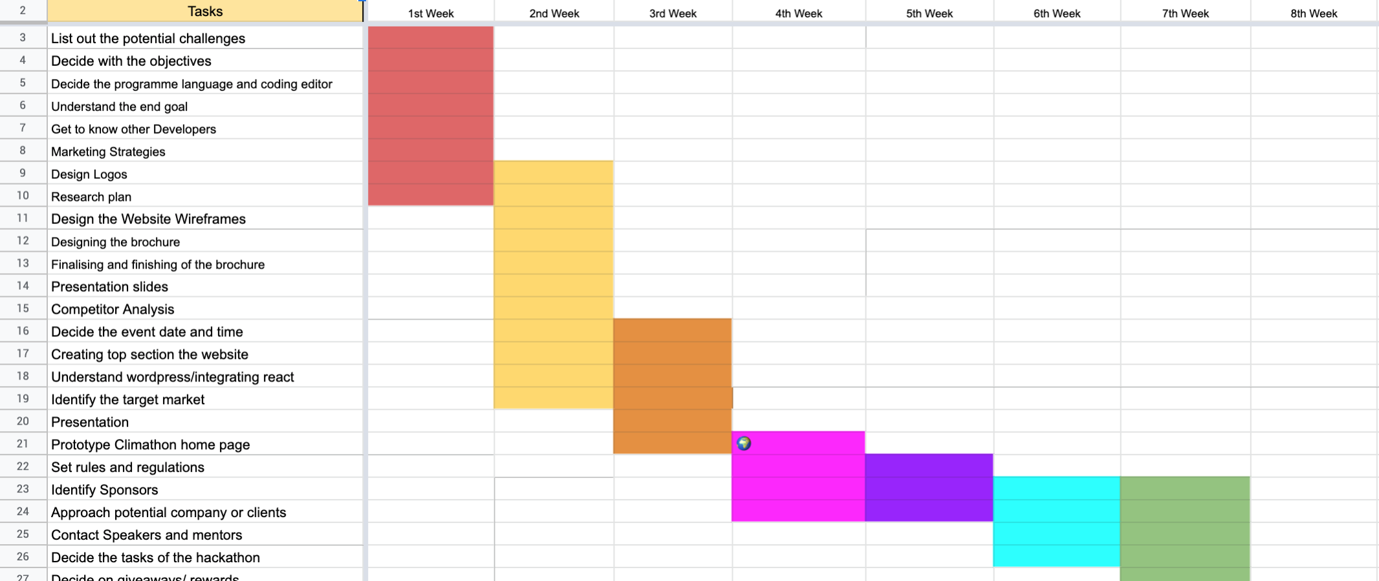
Timeline

Slide 17
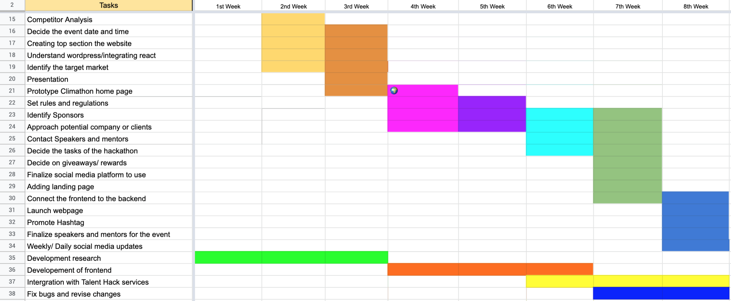
Timeline

Slide 18
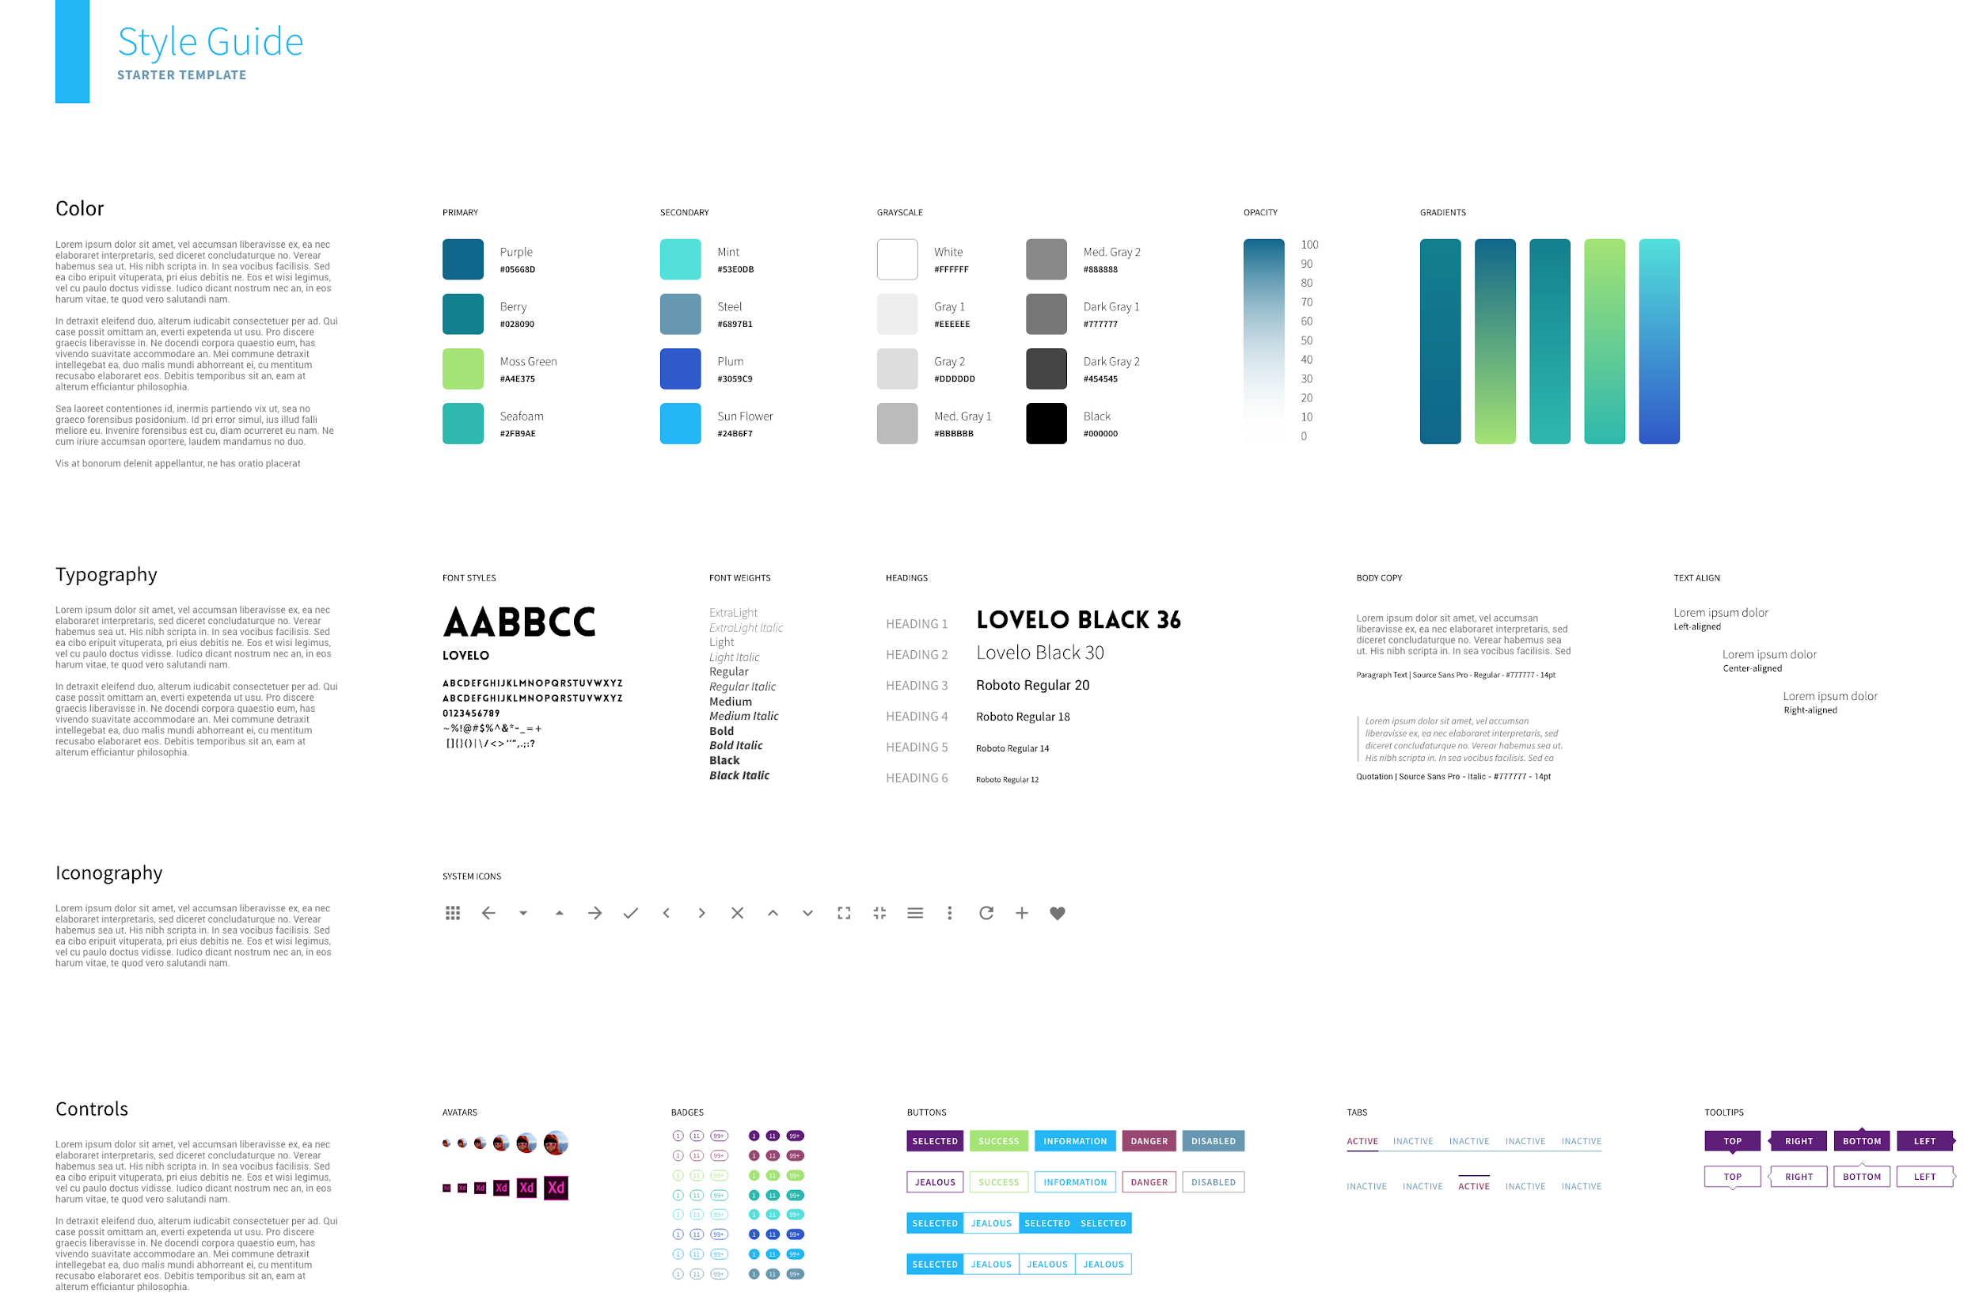
Style Guide

Slide 19
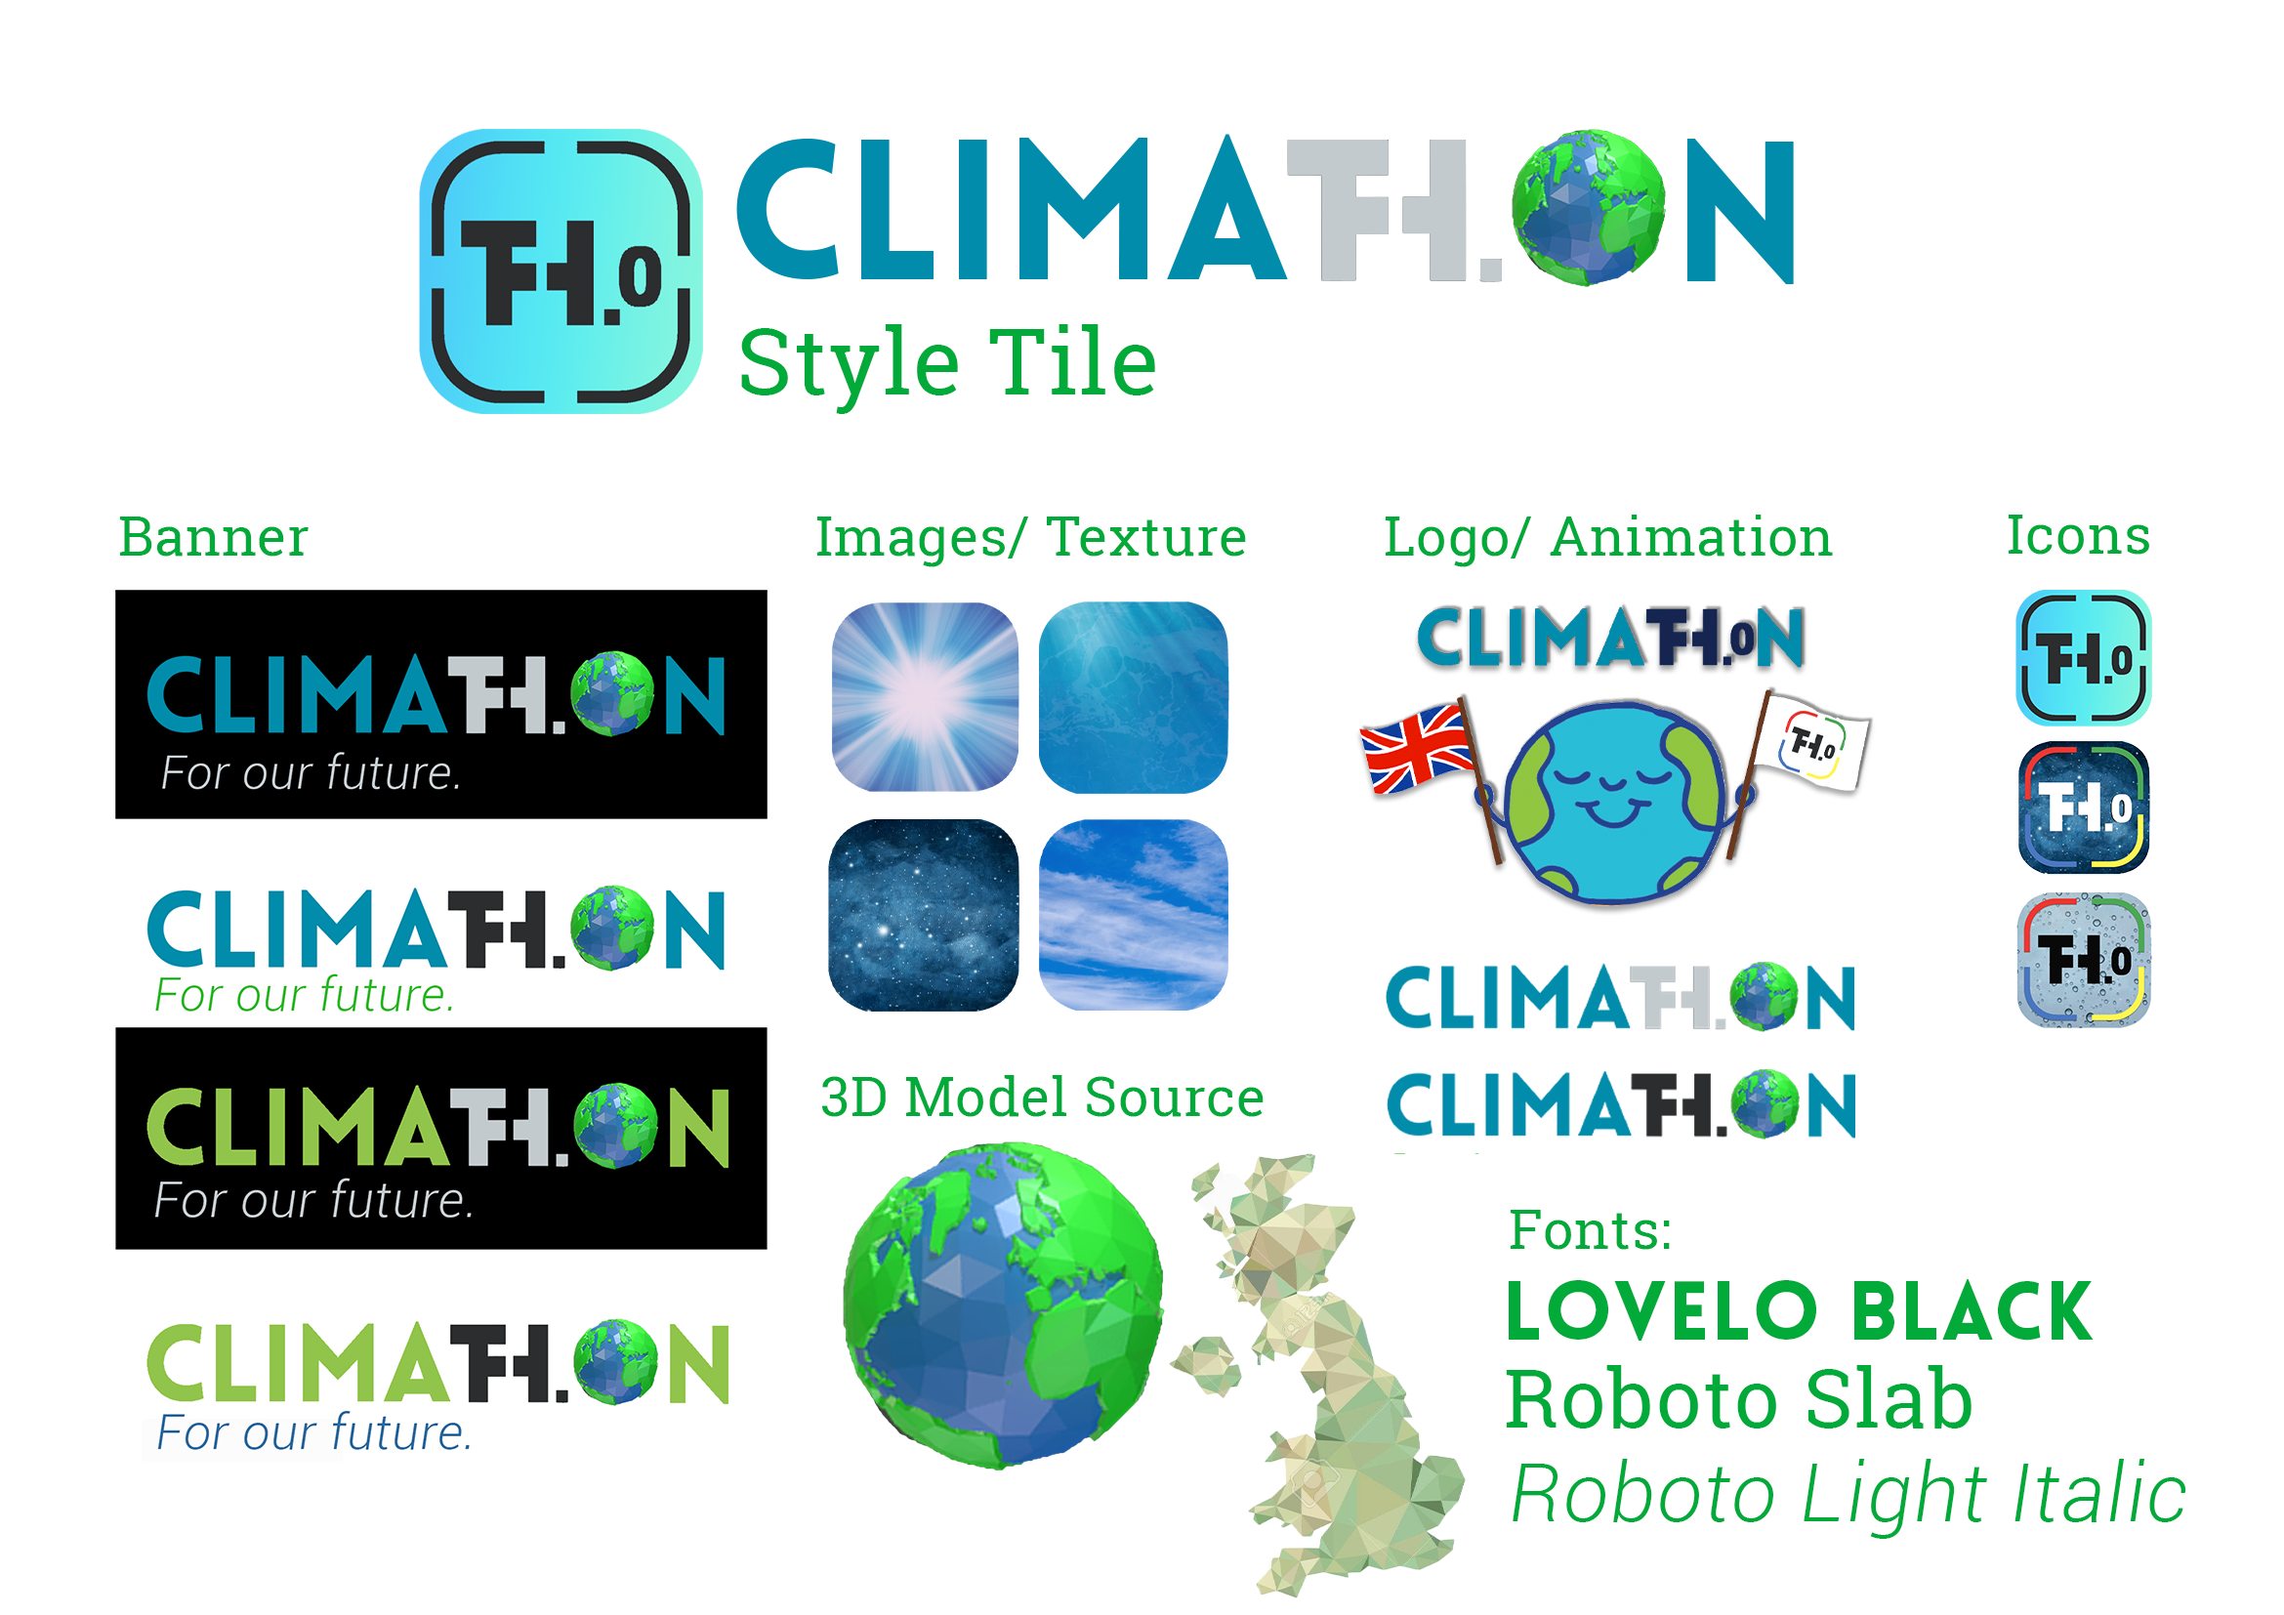
Style TILe

Slide 20
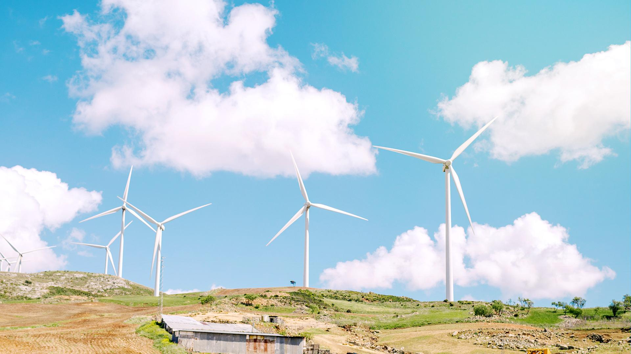
PROTOTYPE IN PROGRESS

Slide 21
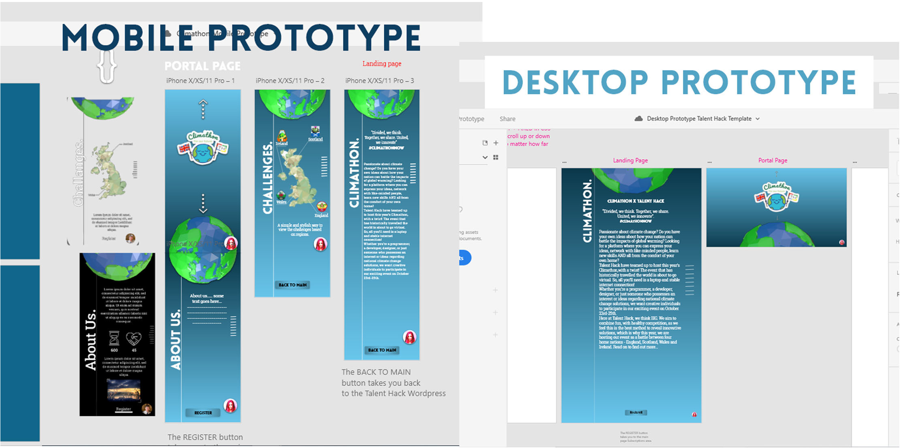
PROTOTYPE IN PROGRESS
A picture is worth a thousand words

Slide 22
Mockups
STYLE TILE
You can replace the image on the screen with your own work. Just delete this one, add yours and send it to the back

Slide 23
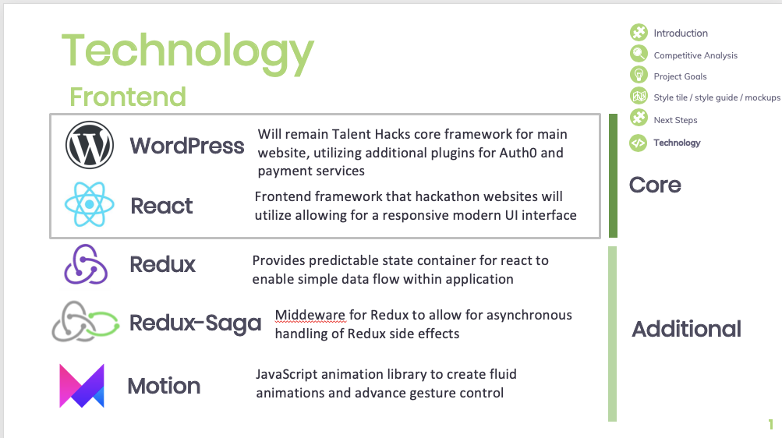
Frontend
Technology
TECHNOLOGY
Introduction
Competitive Analysis
Project Goals
Style tile / style guide / mockups
Next Steps
Core
Additional

Slide 24
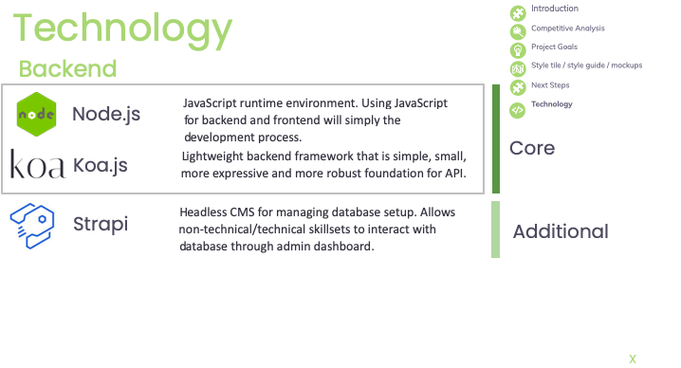
Backend
TECHNOLOGY
Core
Additional

Slide 25
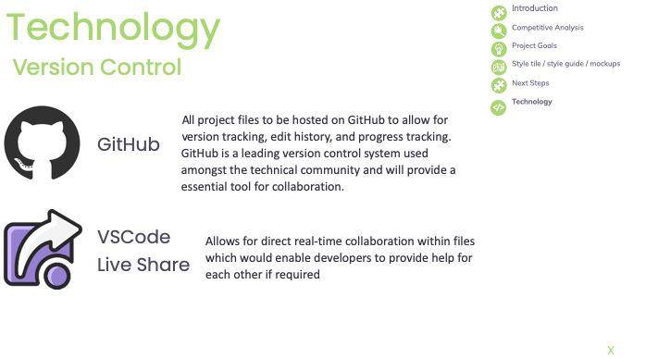
Version Control
TECHNOLOGY

Slide 26
Thanks!
Please keep this slide for attribution.
Do you have any questions?
youremail@freepik.com +91 620 421 838 yourcompany.com

